Slide 1

BUSINESS TRENDS OF MOBILE REPAIR INDUSTRY THROUGHOUT THE GLOBE DUE TO COVID-19

Slide 2

GROUP MEMBERS
Arslan Afzal (MSDS20035)
Ahmad Nawaz (MSDS20093)
Muhammad Uzair (MSDS20053)

Slide 3

PROBLEM STATEMENT
The statistical analysis on repair industry trend in the form of jobs, revenue, demand and supplies impacted due to covid-19 as compared to normal days.

Slide 4

INTRODUCTION
The outbreak of coronavirus disease (COVID-19) has severely affected national and global economies. We have an independent data yearly base in two groups 2019 and 2020 with insight attributes purchase expense, earnings and employees, so we applied different statistical tests T-test and Cross Tabulation .It is used to compare a sample mean with a known population mean or some other meaningful, fixed value.

Slide 5

MOTIVATION
Employees Safety Problem and Unemployment
Cash, Electronic Payment Systems and Repair jobs
The Impact Of Covid-19 on Small/Medium Business Owners
Repair Desk Pos Data to Find out Trends of Mobile Repair Industry

Slide 6
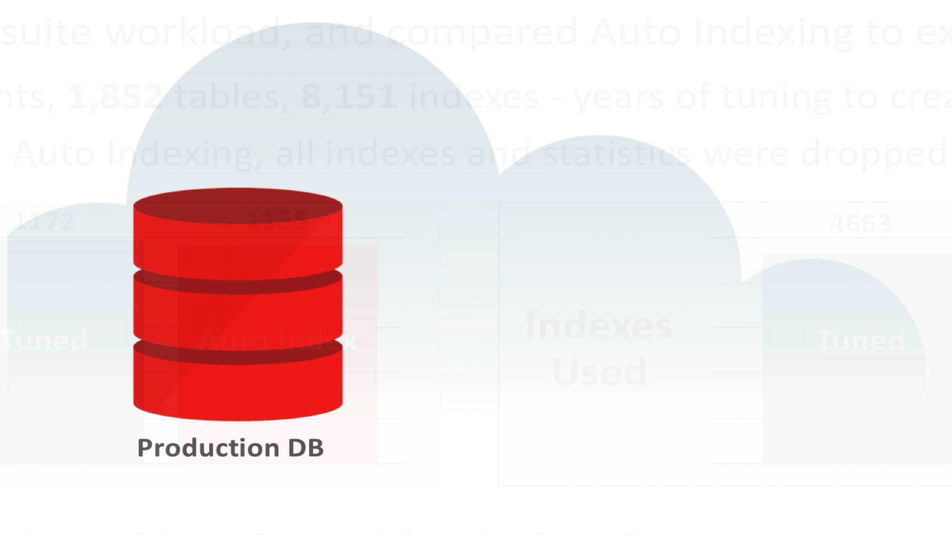
DATASET DESCRIPTION
The data used in this project is scraped from different distributed databases of product (Repair desk) under the supervision of company who owns copyright of the product due to data sensitivity and privacy. The technique used in collecting the data is named as ETL (Extraction, Transformation, Load).
Complete Dataset
Attributes | Total Values
Country | 37
Business | 446
Employees | 26493
Records | 10704
Revenue | 2993590794
Purchase Expense | 119604

Slide 7
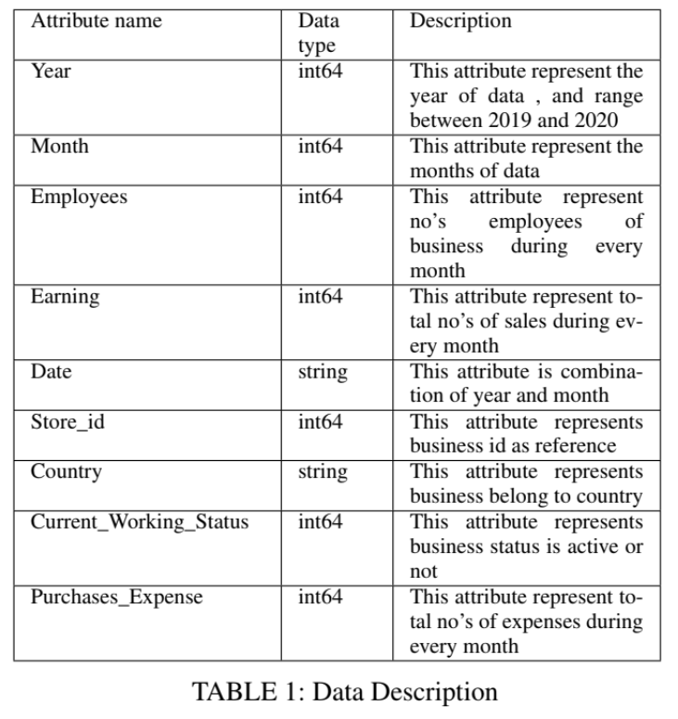

Slide 8
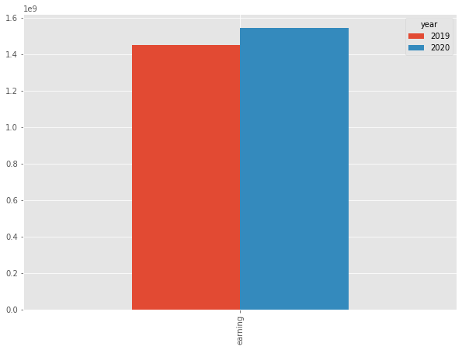
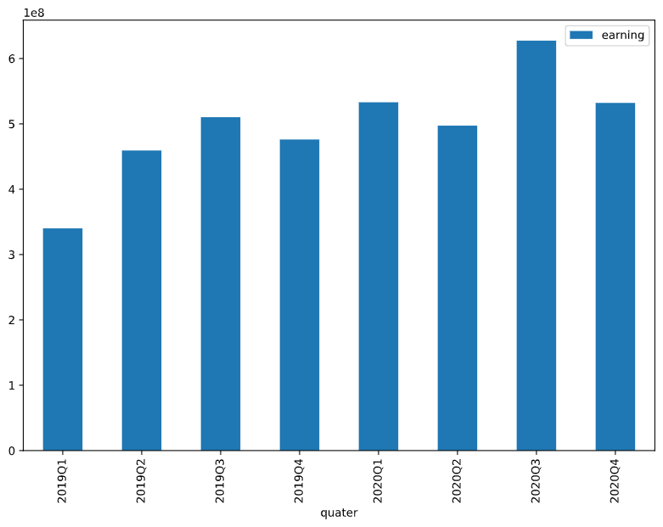
YEARLY AND QUARTERLY BASED DATA VISUALIZATION
1-3 Min

Slide 9

PRE-PROCESSING DATA
DATA CLEANING
Missing values were replaced by the mostly occurring value of that attribute subject to its
related output.
DATA FORMATTING
To relate the data and make it meaningful year and month columns were merged in the date column to get a sense of every month earning data.

Slide 10

METHODOLOGY
T-Test
Cross Tabulation

Slide 11
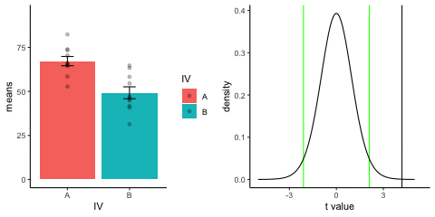
T-Test
T-tests can be used in real life problem to compare averages. so according to the problem, we applied to our dataset and test on different groups of data on a yearly basis. T Score Value greater and small tell respectively dissimilarity and similarity of groups.
In Terms:
Year and Earning
Year and Employee
Year and Purchase Expense

Slide 12

Independent Sample T-Test Between Year and Earning
Ho = The earnings in 2020 is greater than or equal to earnings in 2019
H1 = The earnings in 2020 is less than the earnings in 2019
Group Statistics
 | year | N | Mean | Std. Deviation | Std. Error Mean
Earning | 2019 | 5352 | 270776.3249 | 3254492.39758 | 44486.18965
 | 2020 | 5352 | 288565.0915 | 3467708.82066 | 47400.67986
 |  | T | df | Sig. (2-tailed) | Mean Difference | Std. Error Difference | 95% Confidence Interval of the Difference
 |  |  |  |  |  |  | Lower | Upper
earning | Equal variances assumed | -.274 | 10702 | .784 | -17788.76657 | 65006.50369 | -145213.58390 | 109636.05076
 | Equal variances not assumed | -.274 | 10659.192 | .784 | -17788.76657 | 65006.50369 | -145213.64179 | 109636.10864

Slide 13

Independent Sample T-Test Between Year and No. of Employees
Ho = The no of employees in 2020 were less than or equal to no of employees in 2019.
H1 = The no of employees in 2020 were greater than the no of employees in 2019.
Group Statistics
 | year | N | Mean | Std. Deviation | Std. Error Mean
employees | 2019 | 5352 | 2.46 | 1.978 | .027
 | 2020 | 5352 | 2.49 | 2.015 | .028
 |  | t | df | Sig. (2-tailed) | Mean Difference | Std. Error Difference | 95% Confidence Interval of the Difference
 |  |  |  |  |  |  | Lower | Upper
employees | Equal variances assumed | -.915 | 10702 | .360 | -.035 | .039 | -.111 | .040
 | Equal variances not assumed | -.915 | 10698.376 | .360 | -.035 | .039 | -.111 | .040

Slide 14

Independent Sample T-Test Between Year and Purchase Expense
Ho = The purchase expense in 2020 is greater than and equal to purchase expense in 2019
H1 = The purchase expense in 2020 is less than purchase expense in 2019
Group Statistics
 | year | N | Mean | Std. Deviation | Std. Error Mean
purchase expense | 2019 | 2982 | 16.52 | 23.538 | .431
 | 2020 | 4169 | 16.87 | 26.559 | .411
 |  | t | df | Sig. (2-tailed) | Mean Difference | Std. Error Difference | 95% Confidence Interval of the Difference
 |  |  |  |  |  |  | Lower | Upper
purchase expense | Equal variances assumed | -.575 | 7149 | .565 | -.349 | .608 | -1.541 | .842
 | Equal variances not assumed | -.586 | 6830.944 | .558 | -.349 | .596 | -1.517 | .819

Slide 15
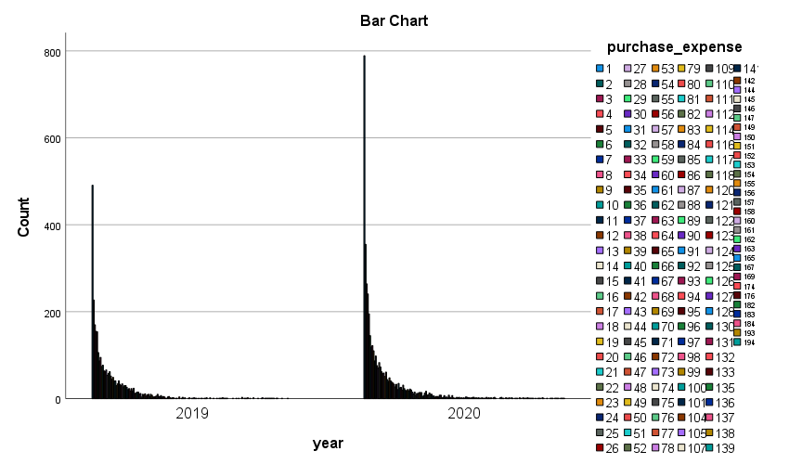
Cross Tabulation
Cross tabulations enable you to examine relationships within the data that might not be readily apparent when analyzing total data collected.

Slide 16

EXPERIMENT & ANALYSIS
DURING PEAK AND OFF-PEAK TIME COVID-19
Workforce Comparison
Revenue Comparison
Repair Industry Expenses Comparison
Yearly Comparison Table
Sr.No | Year | Employees | Purchase Expense | Revenue | Result
1 | 2019 | 13152 | 49268 | 1449192626 | After Comparing Yearly data we conclude Covid-19 is a loss year in each term as compared to 2020.
2 | 2020 | 13341 | 70336 | 1544398168

Slide 17

RESULTS & CONCLUSION
In this paper, we learn about COVID-19 impacts on small and medium size repairing business all through the world.
Small and medium size business revenue increase in 2020 as contrast with 2019
This increase tell us that the employee’s jobs straightforwardly connected with repair jobs and more open opportunities in pandemic.
In T-test of repair industry expenses comparison we find that the small and medium size business cost of purchases increases in 2020 as compare to 2019.
This increase tell us that the demand and supplies needs directly associated with repair jobs to run business.

Slide 18


